Slide 1
Immediate MBTI Personality Diagnosis Through Online Posts
Group 7: Yihang Hu, Jiacheng Yang, Aijia Zhang

Slide 2

Main Structure
Background Introduction & Motivation
Dataset Introduction & EDA
Model Selection & Comparison
Challenges & Improvements
Uncertainty & Prospective
Conclusion

Slide 3
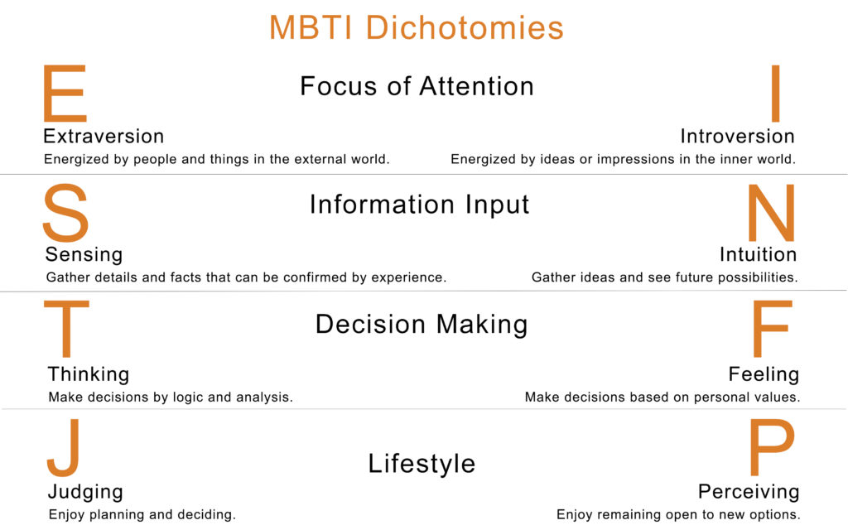
MBTI
History
Four Dichotomies

Slide 4
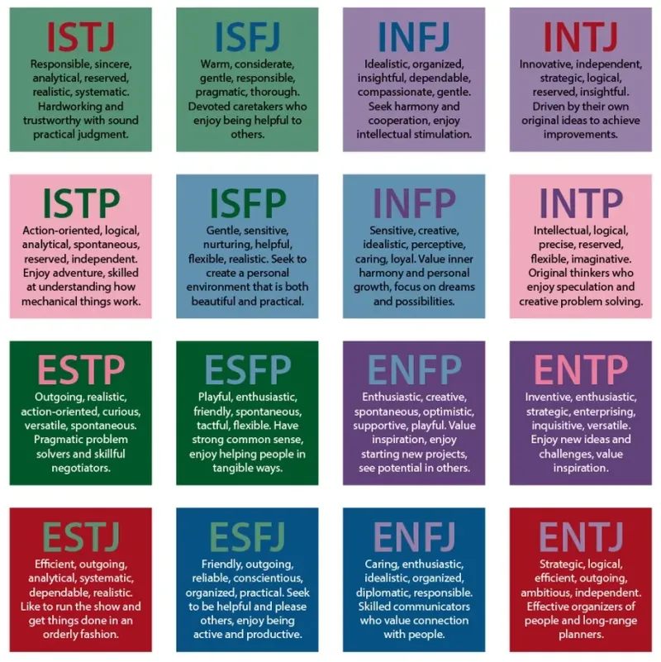
Application
Interests
Psychological Counselling
Company

Slide 5
Motivation
Test-taking is a time-consuming process
Provide a quick & easy way for people to get test results through their daily posts.

Slide 6
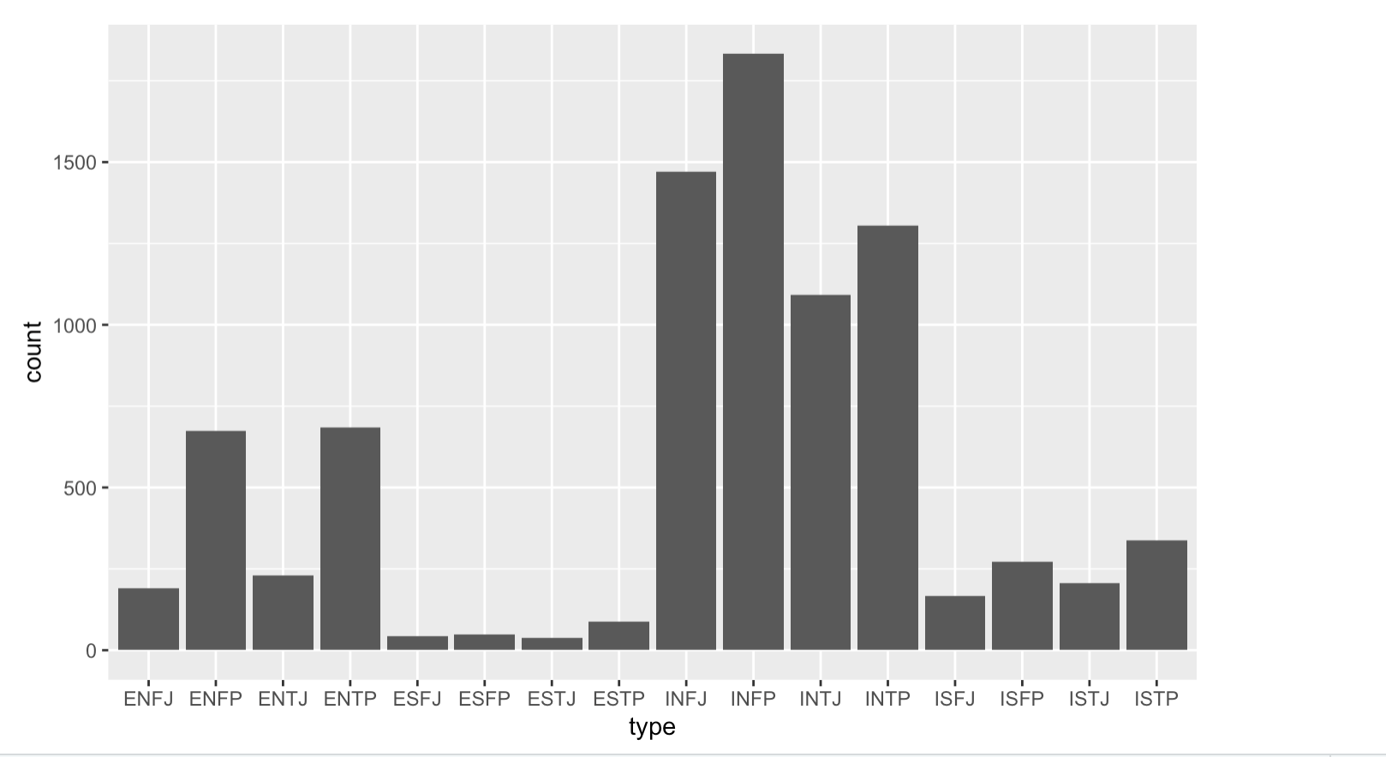
Dataset Introduction
From (MBTI) Myers-Briggs Personality Type Dataset(Kaggle) --> derived from an online MBTI forum
8675 observations
Each includes two columns: individual's personality and his/her 50 random posts
Overall Look:
Majority of data are from IN group
Have little data from ES group
ES – IN comparison

Slide 7
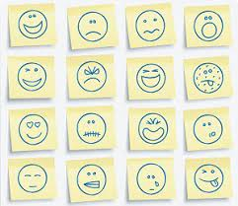
Data Building —— summarize each post
Avg_comment_length: average number of words in individual's 50 posts
EorI,NorS,TorF,JorP
Ellipses,Exclamation,Question,Links,Picture,Emojies,Upper
Sentiment building(vaderSentiment): VADER sentiment analysis relies on a dictionary which maps lexical features to emotion intensities called sentiment scores. The sentiment score of a text can be obtained by summing up the intensity of each word in the text.

Slide 8
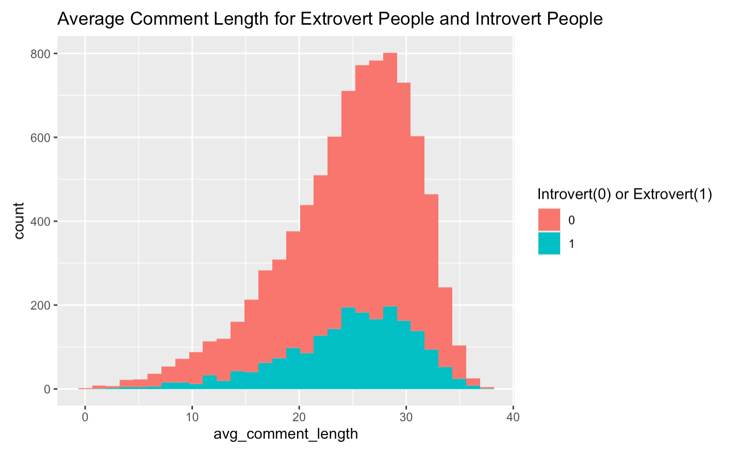
EDA Question 1: Do extrovert people overall speak more than introvert people?
Different counts, but similar distribution pattern
The mean value of average comment length for introverts is 24.5057, a little bit smaller than that of extroverts(24.5887)

Slide 9
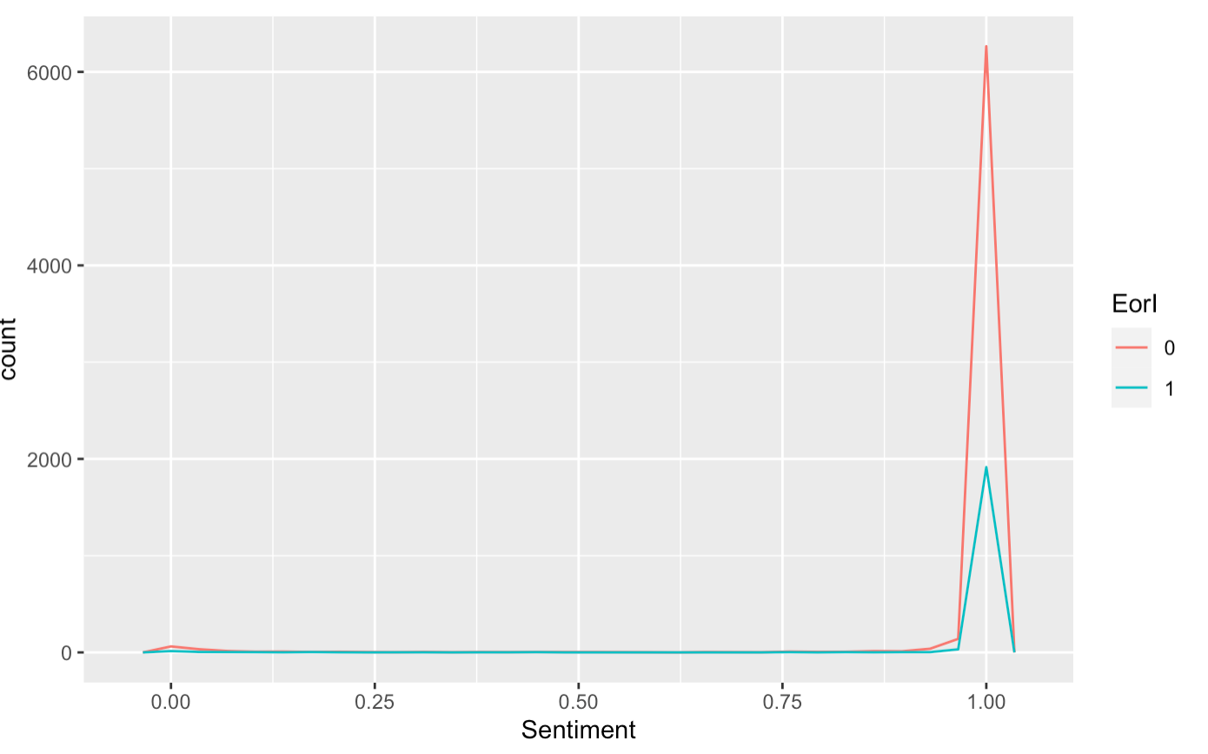
EDA Question2: Do extrovert people have more positive feelings(measured by sentiment score) than introverts?
Different counts, but similar distribution pattern
Introverts's average sentiment score is 0.973, which is a little bit lower than that of extroverts(0.98)

Slide 10
Experiment

Slide 11
Models Candidates
Naïve Bayes
LinearSVM
Random Forest

Slide 12
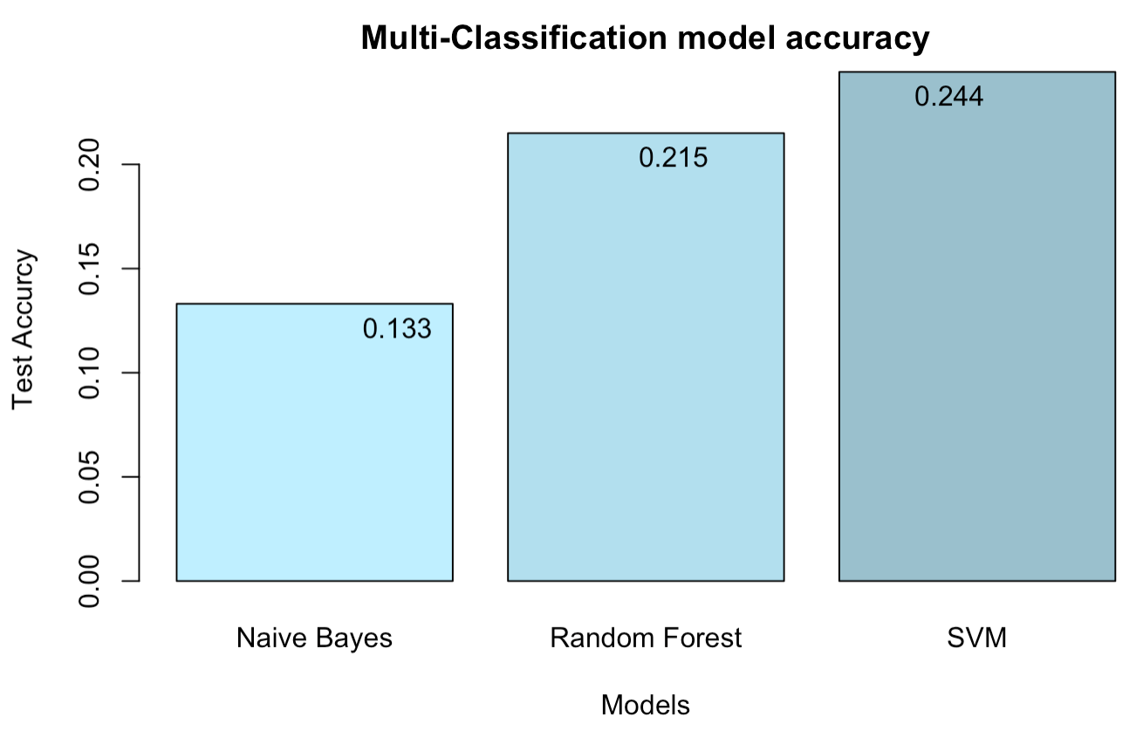
Multi-classification

Slide 13
Any method to improve the Accuracy?
All personality dichonomyes are independent of each other
Choose to do binary classification for 4 times:
Introversion vs Extroversion,
Sensing vs Intuition,
Thinking vs Feeling,
Judging vs Perceiving

Slide 14
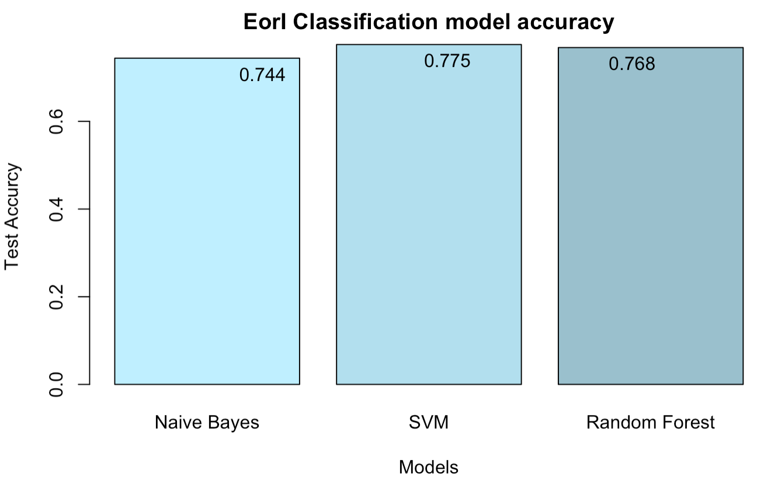
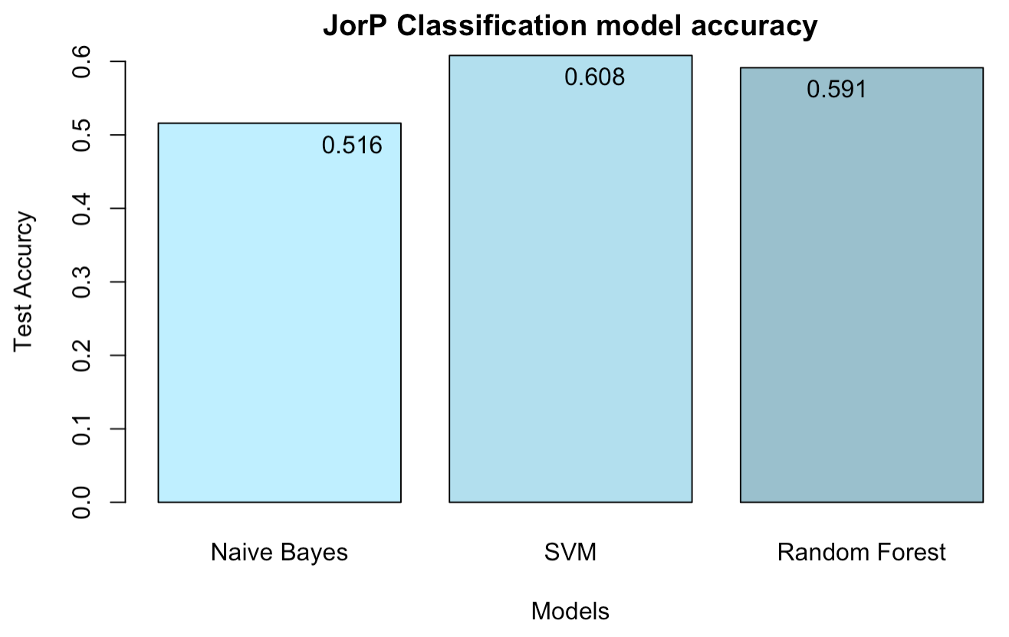
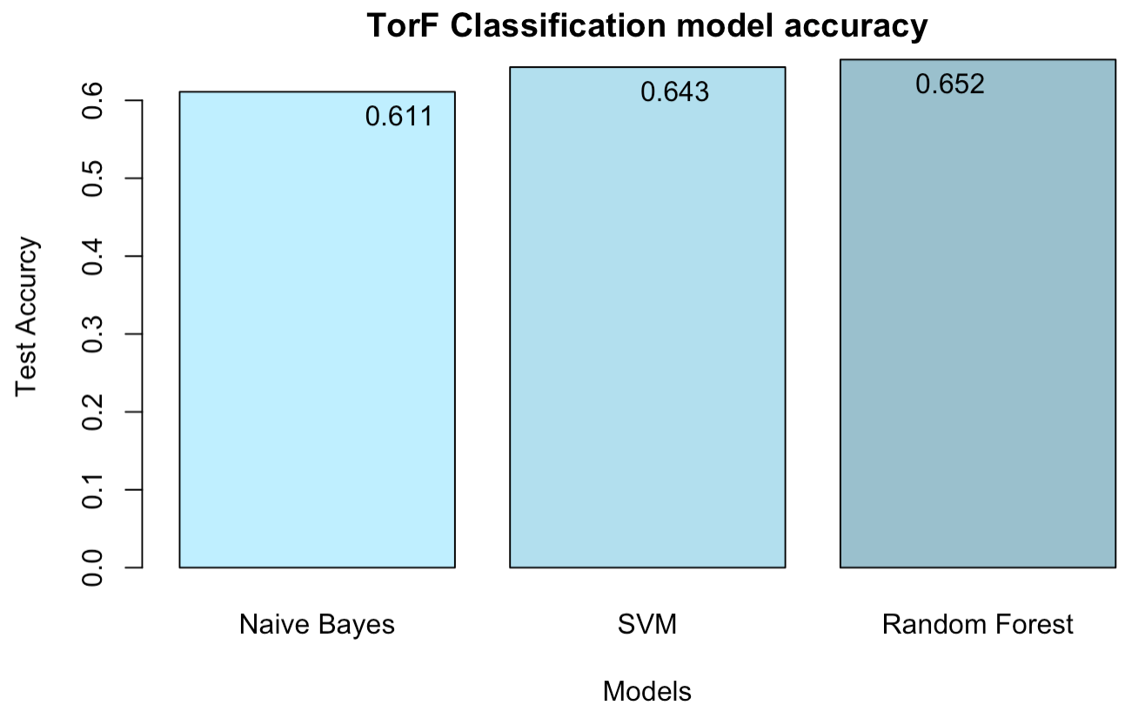

Binary Comparison

Slide 15
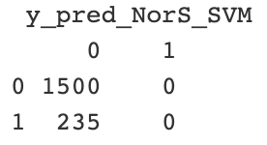
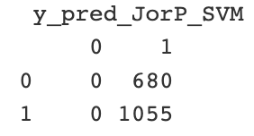
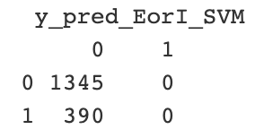
Problem of LinearSVM
Overfitting : It is very much possible that due to imbalance, the model fails to learn pattern of one class and gets biased towards another class.
Random Forest has the best performance!

Slide 16
What if we use posts themselves to do the classification?

Slide 17
Recurrent Neural Networks (RNNs)
A typical machine learning model based on bag of words model considers the words in isolation, BUT
a type of neural network that has hidden states and allows past outputs to be used as inputs
“The concert was boring for the first 15 minutes while the band warmed up but then was terribly exciting.”

Slide 18
Long short-term memory (LSTM)
LSTM, a special kind of Recurrent Neural Networks(RNN)
"The cat, which already ate a fish, still tries to find something to eat."
Be able to capture long-term dependencies and prevent gradient vanishing of RNN

Slide 19
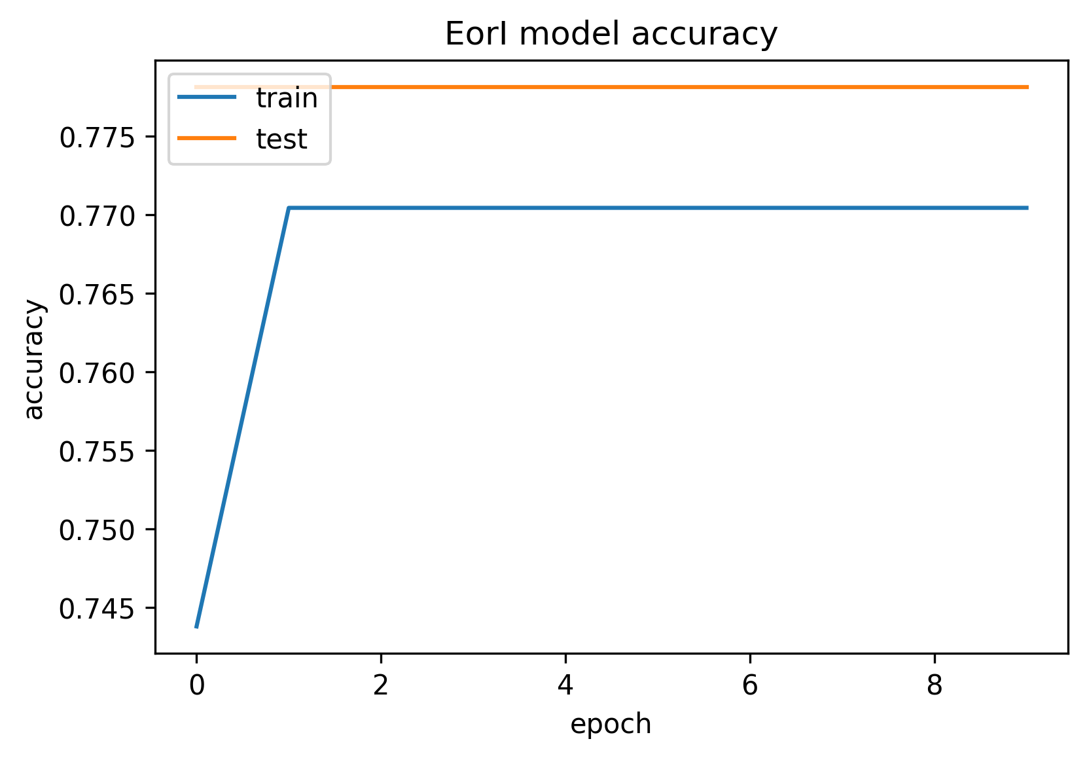
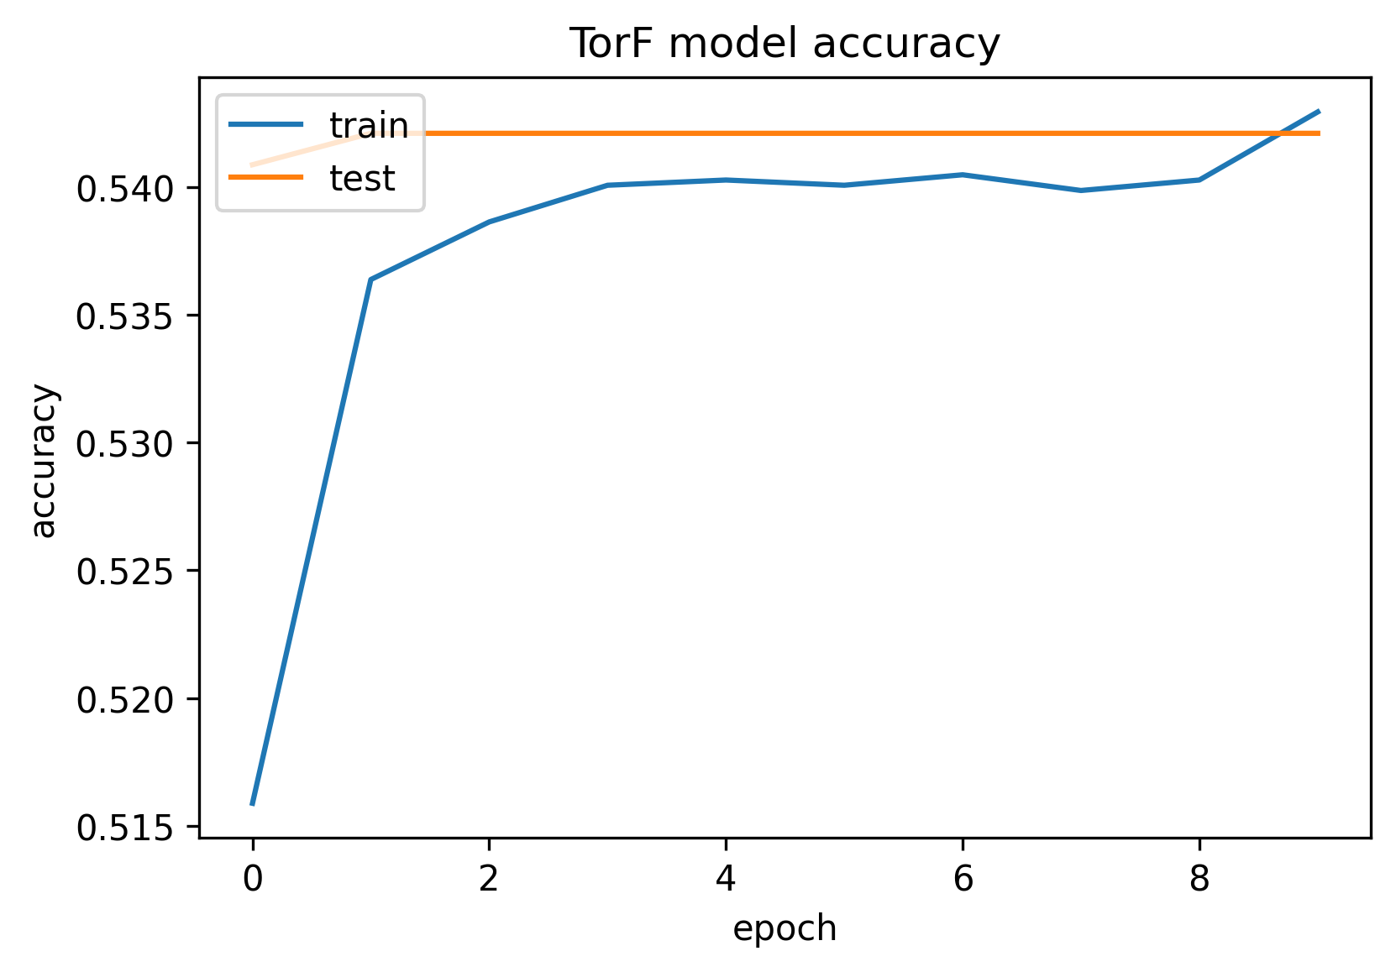
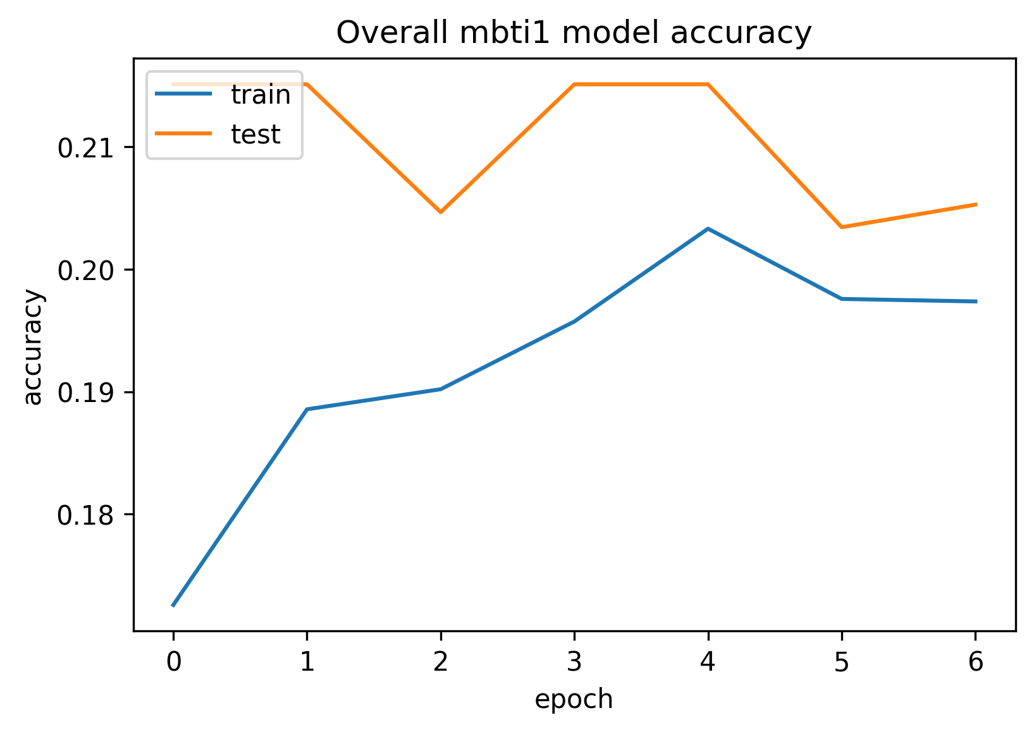
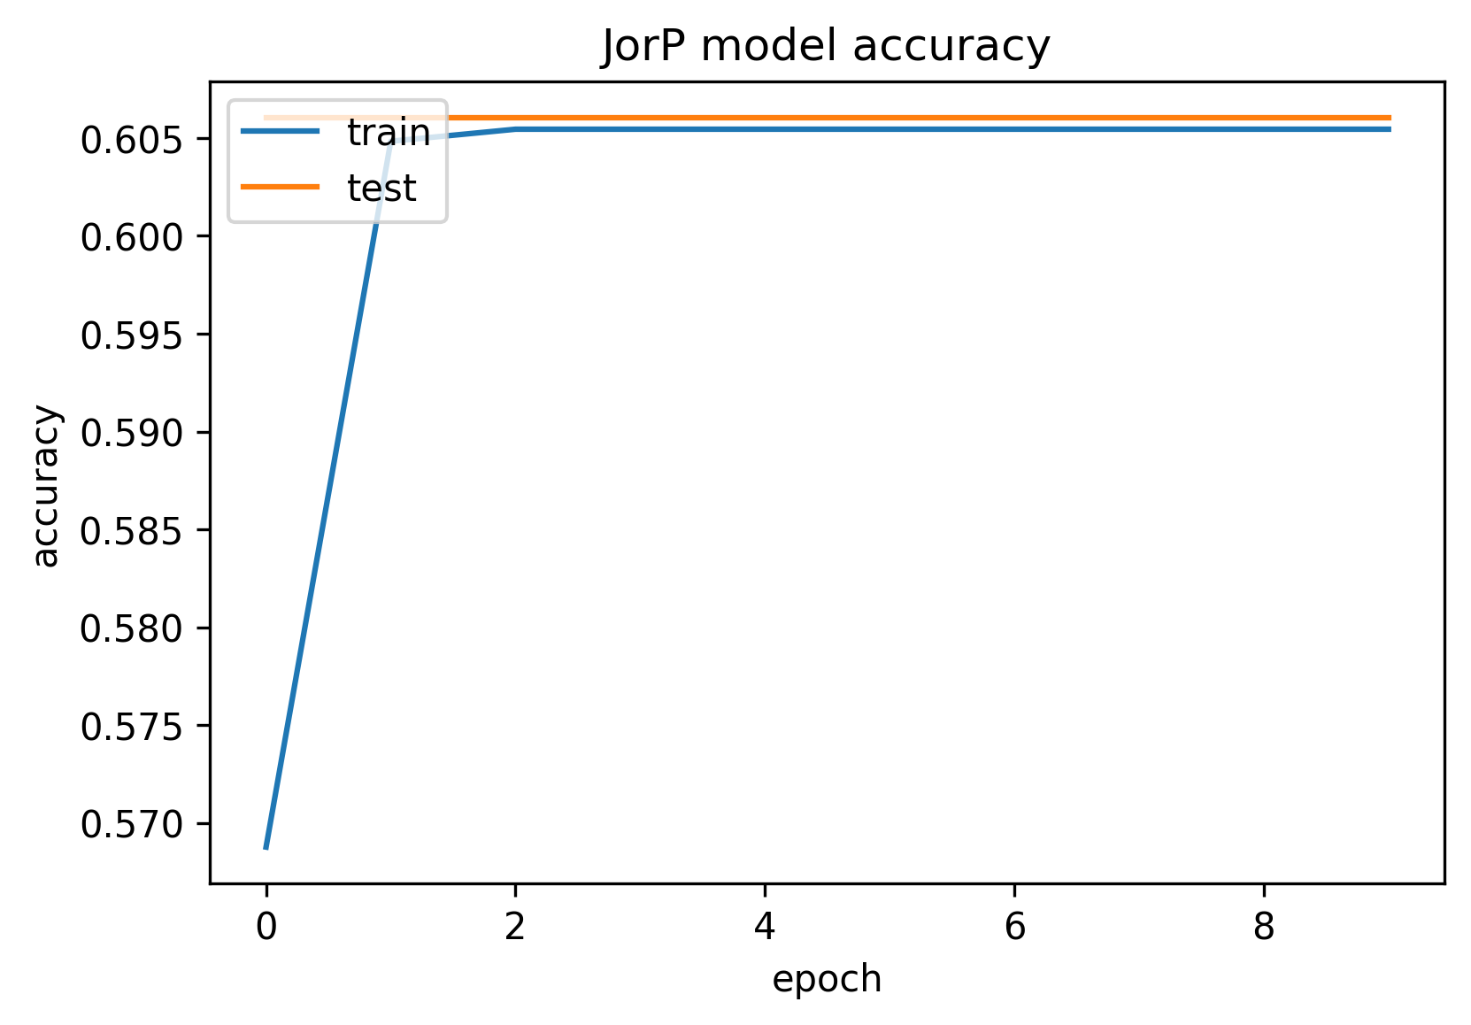
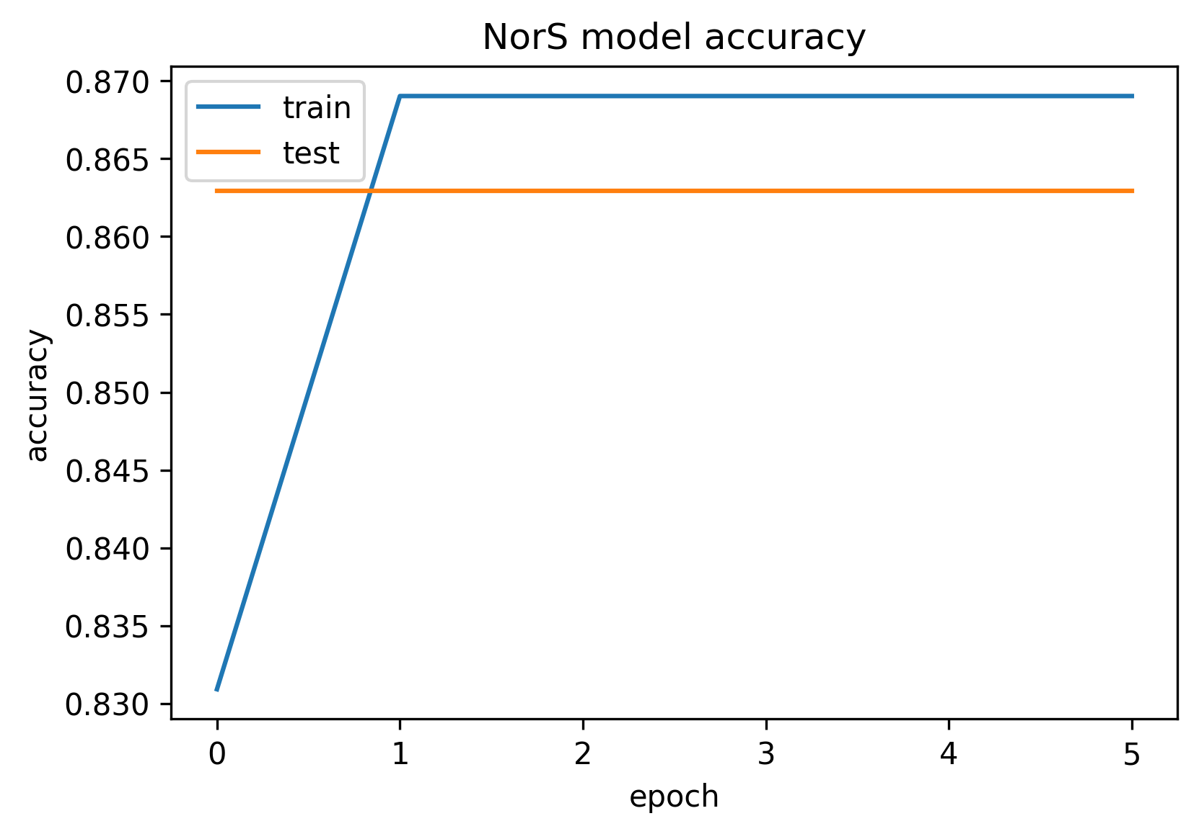
After the training...

Slide 20
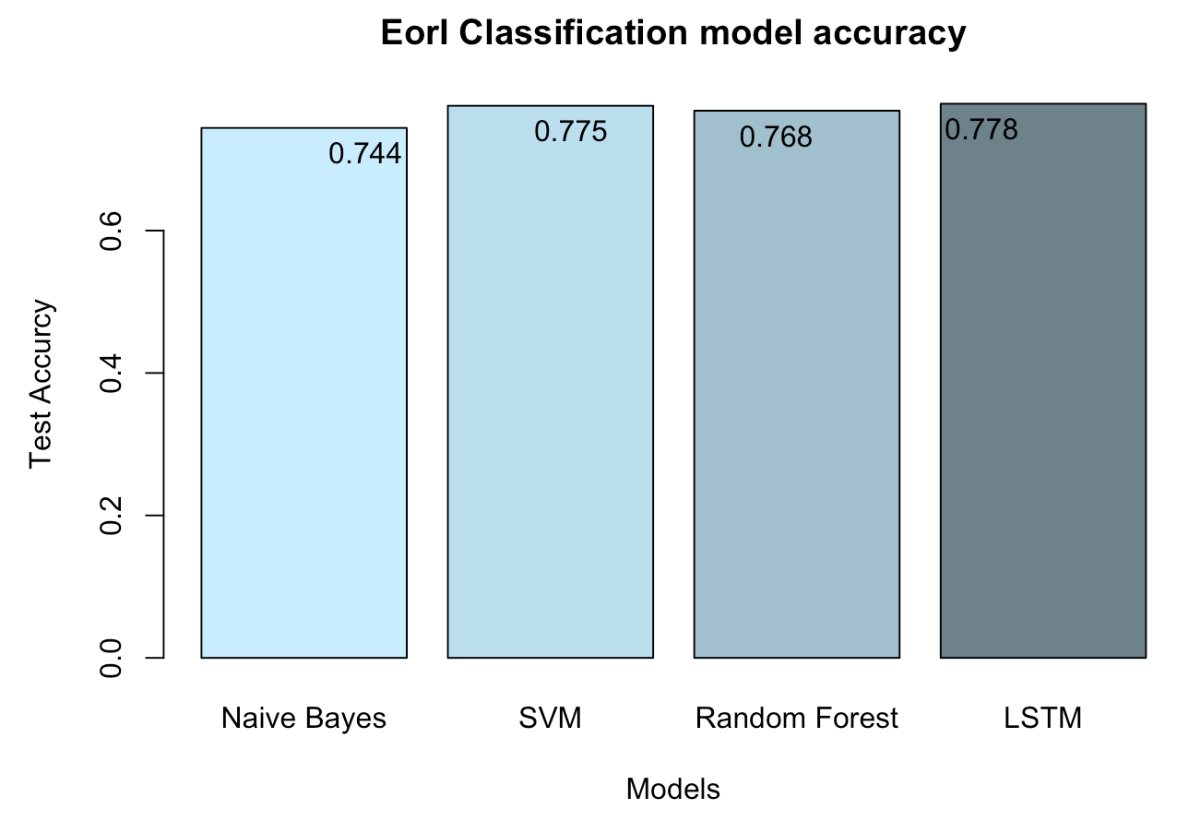
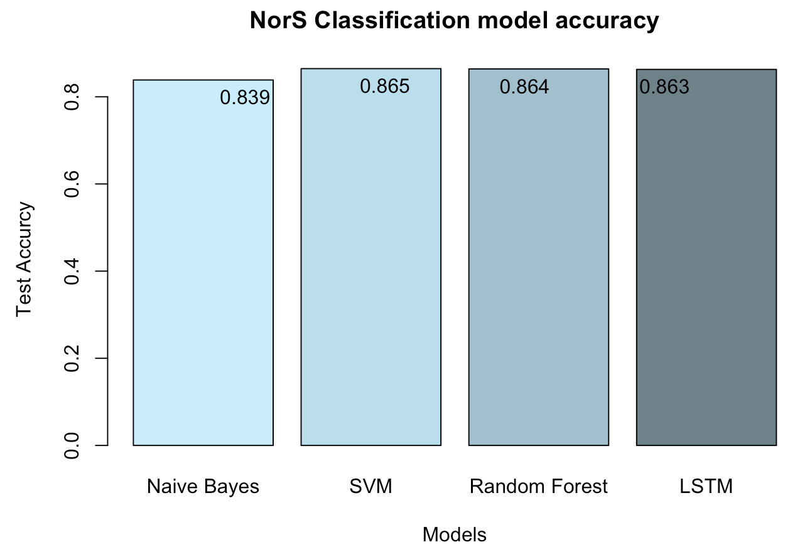
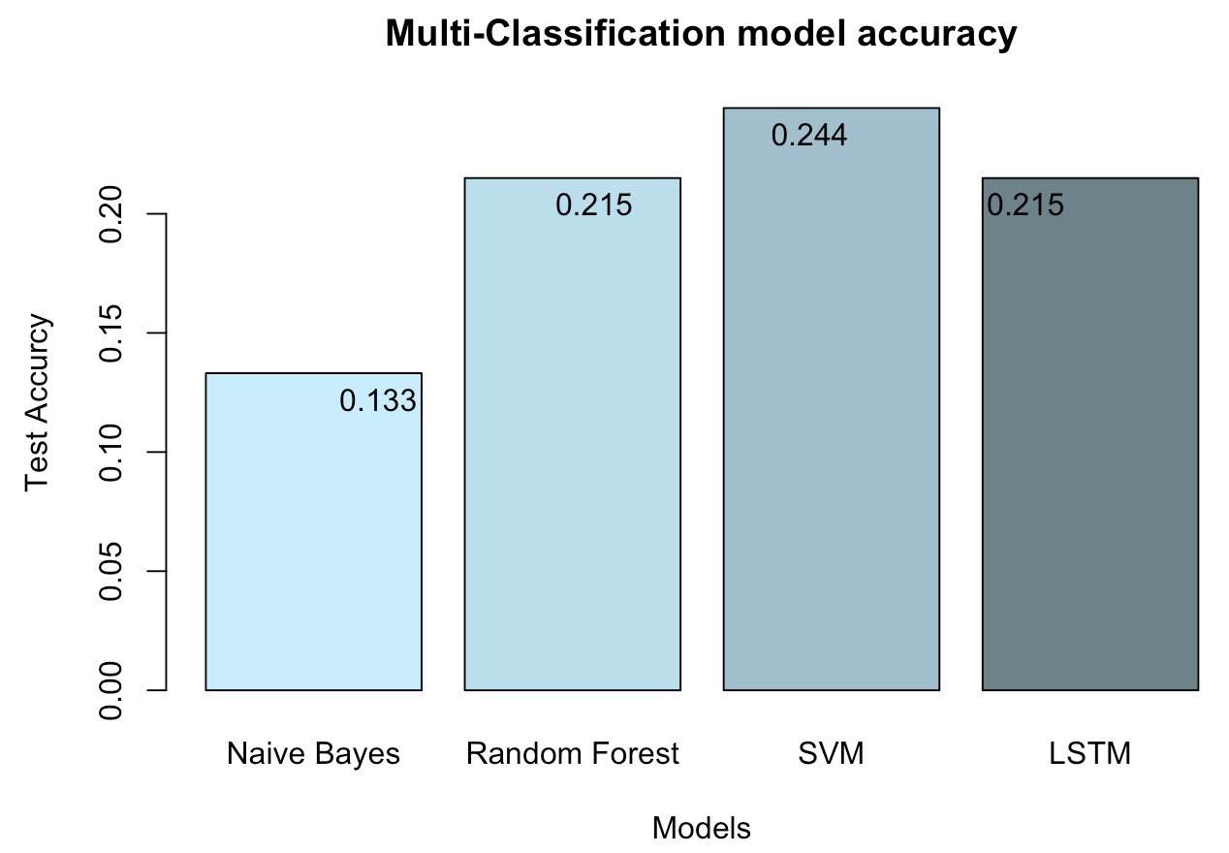
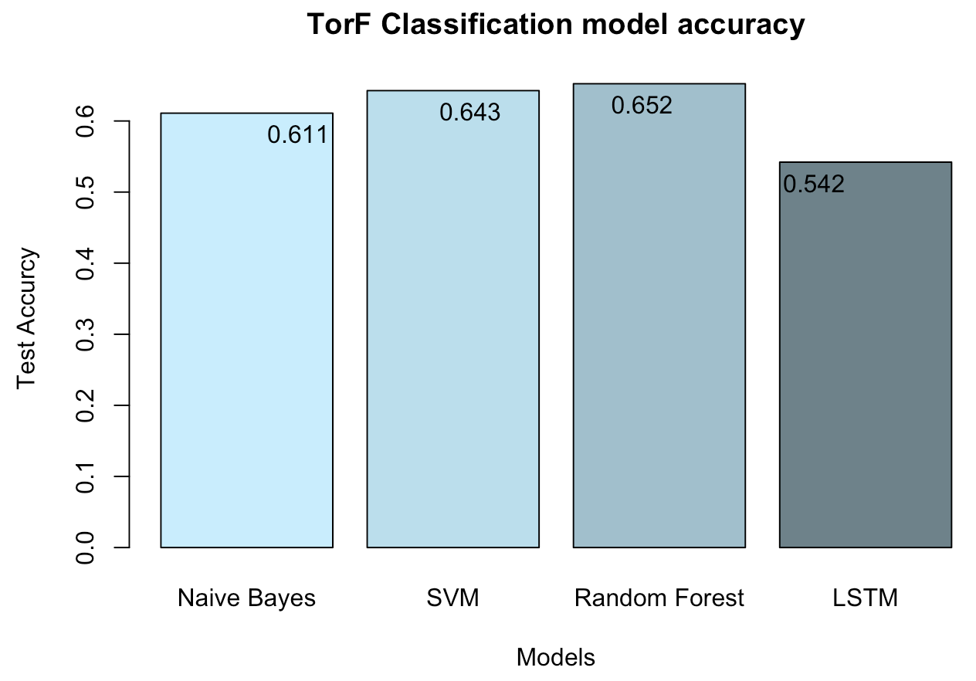
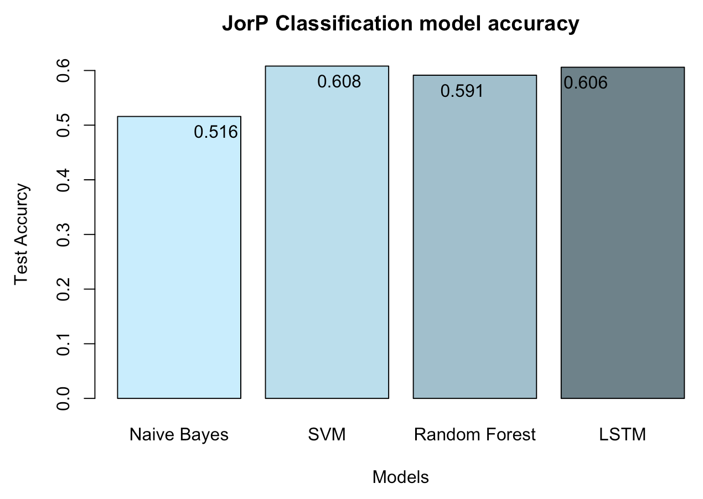
Comparison

Slide 21
Thinking--Why LSTM does not have a better performance?
Information loss!
When we used LSTM to do the classification, we ignored many features such as emojis, links, etc., which are covered when we used Naïve Bayes, SVM, and Random Forest to do the training.
Small data size!
The content is not enough for LSTM to learn the pattern by training.

Slide 22
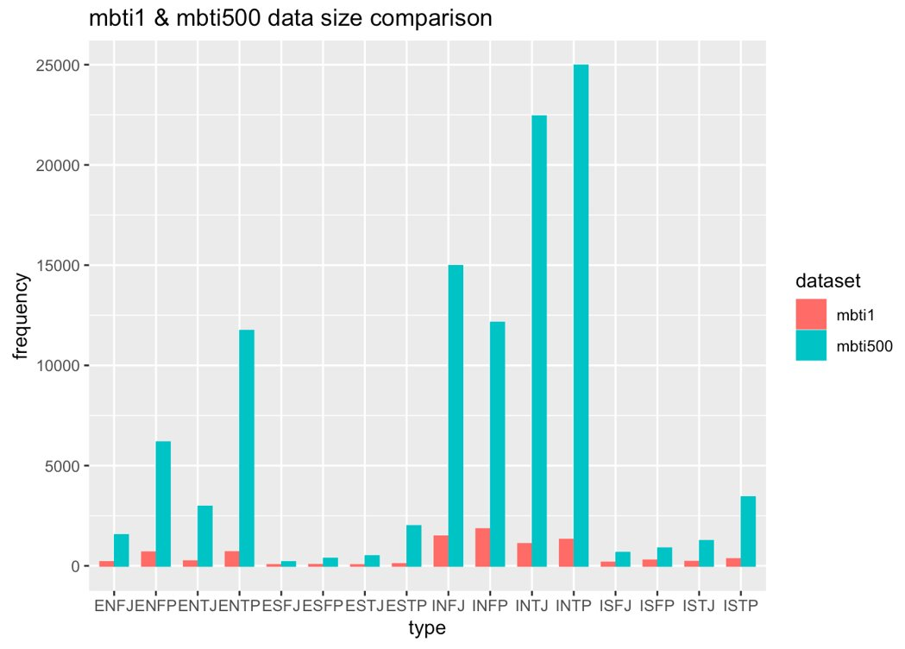
Another experiment
A new dataset
With larger size and more content
Without other features like links, but only content

Slide 23
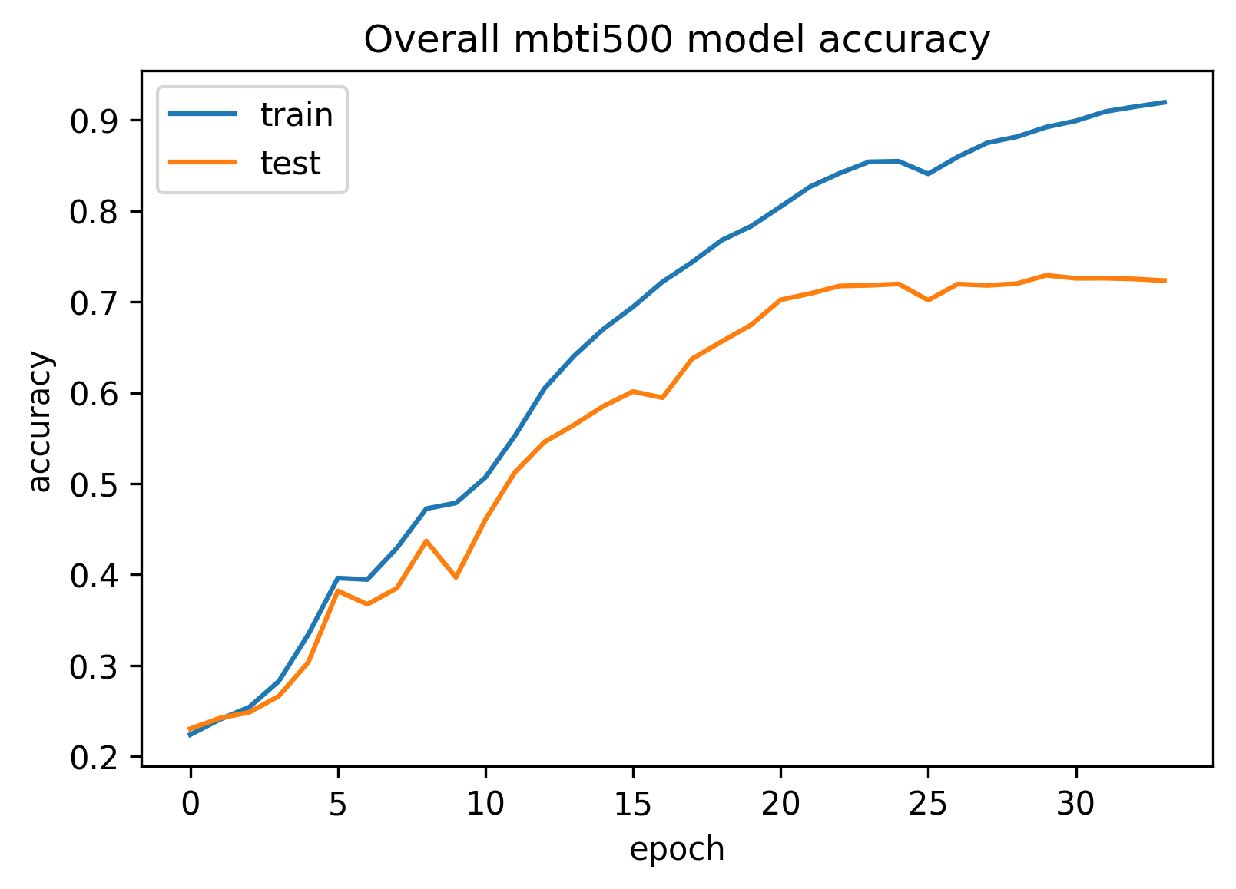
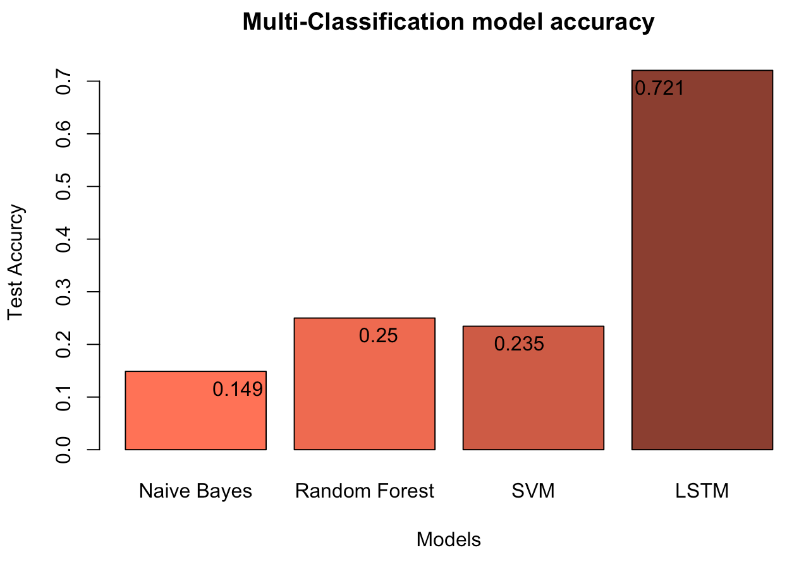

Slide 24
Conclusion
When we want to predict a person's personality type based on his posts and along with all kinds of elements his posts have, like number of links and emojis, Random Forest can do a great job.
However, if we want to do the prediction only based on the poster's writing pattern and content, LSTM seems to be the better choice, as long as enough data is provided.

Slide 25
Potential Problems —— Unbalanced Data
Lack of data for certain groups could lead to classification error
ESFJ 12% of general population
ESTJ 8.5% of general population
ESFP 8.5% of general population
ESTP 4% of general population
***They only take up 2.5% of the sample data

Slide 26
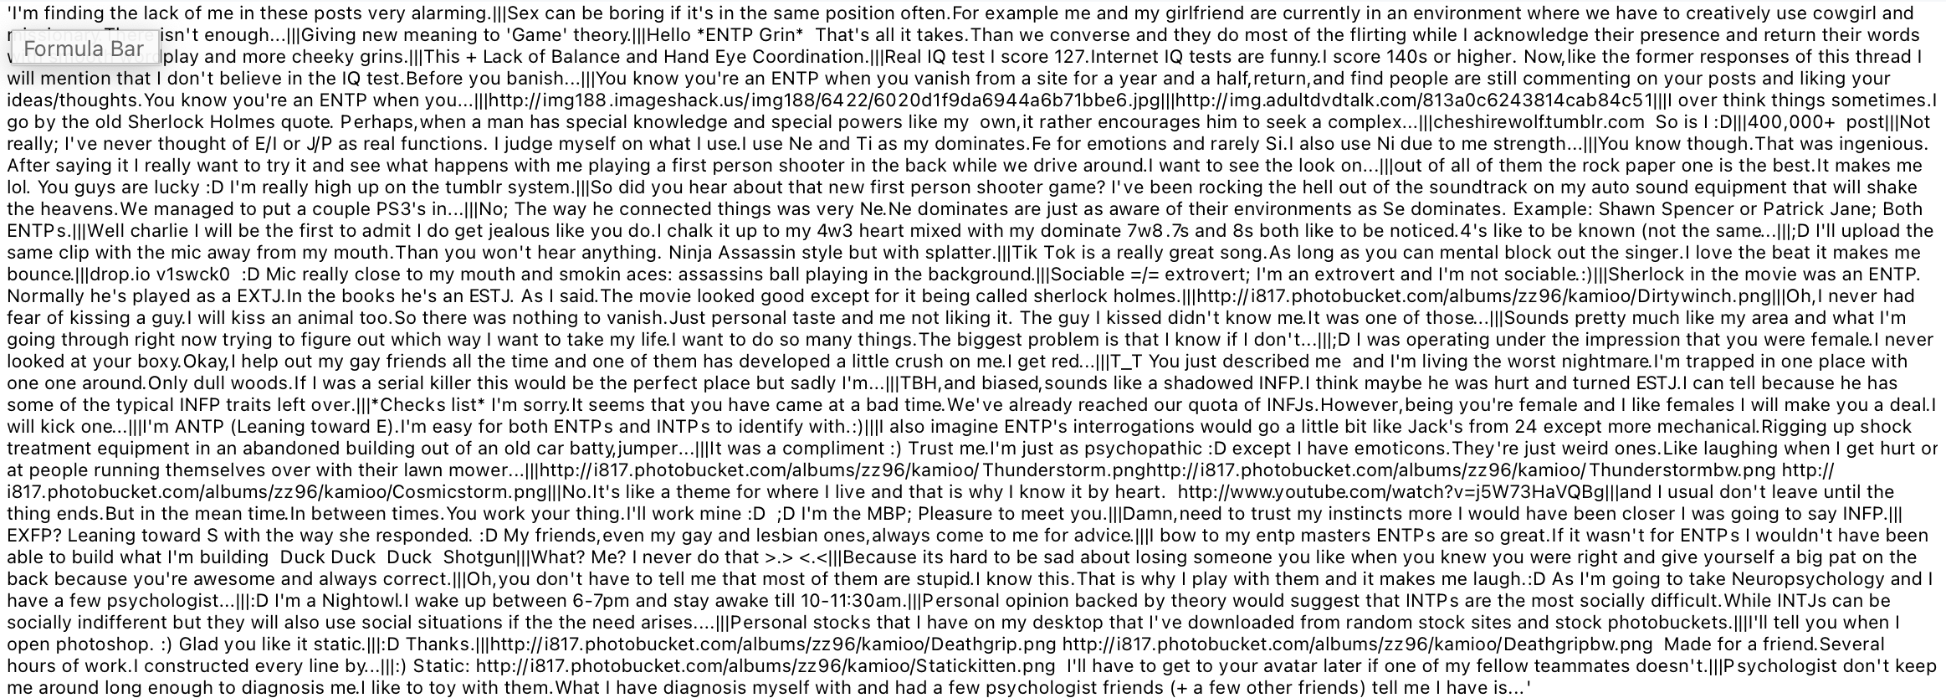
Potential Problems —— Inconvenient to Apply

Slide 27

Prospective
Job Interview
Psychological counseling
Education

Slide 28
Q & A

